Slide 1


LAB 4:
Deploy Existing Postgresql Service Broker

Slide 2
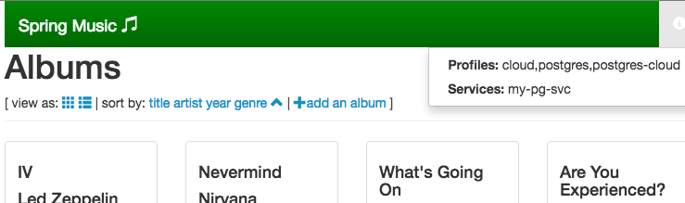
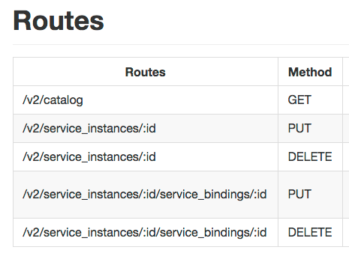
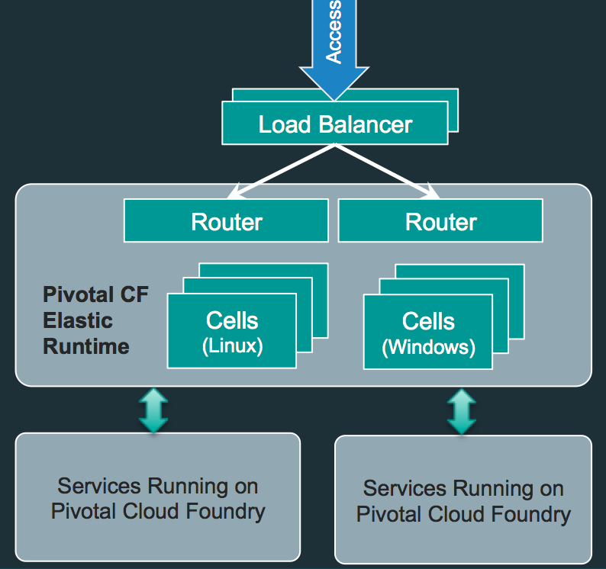
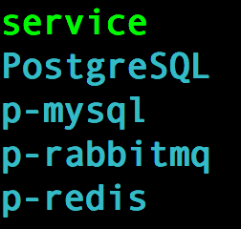
Lab 4: Big Picture
Push Broker App
postgresql-cf-service-broker
spring-music
PcfDev: 192.168.11.11
Marketplace
3. Push and Bind “sm app” to postgres
Service Instance:
my-pg-svc
$cf create-service
$cf bind app svc
Bosh-Lite 192.168.50.4
2. Configure Broker
Service Broker:
postgresql-cf-service-broker
Enable Service for Marketplace
Postgres
10.68.45.151
Warden container
Bosh Director
VM
VM

Slide 3
Pivotal OpsManager and BOSH

Slide 4



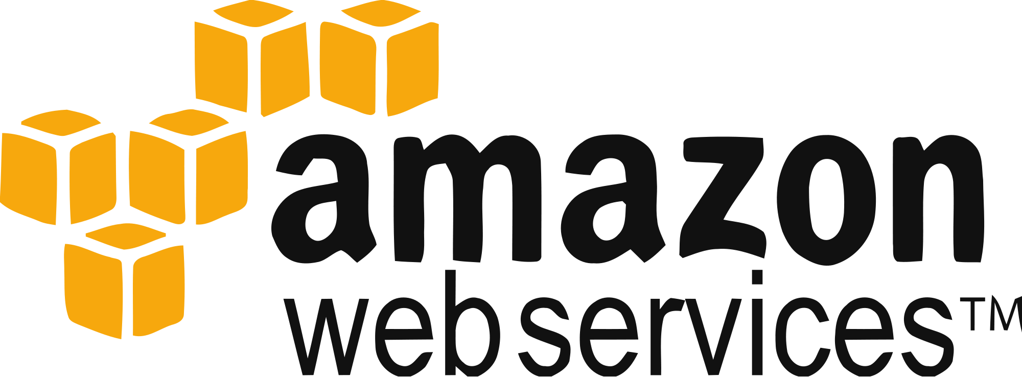
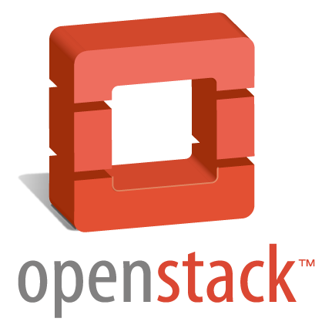
Pivotal OpsManager
Pivotal OpsManager is a web UI that installs and then sits on top of BOSH
BOSH
IaaS

Slide 5
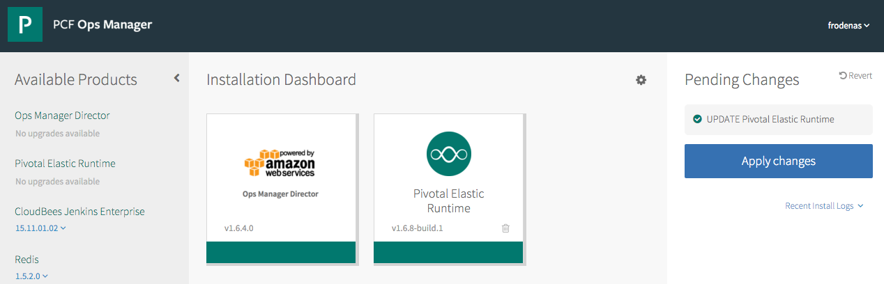
Pivotal OpsManager
Click to install & update

Slide 6
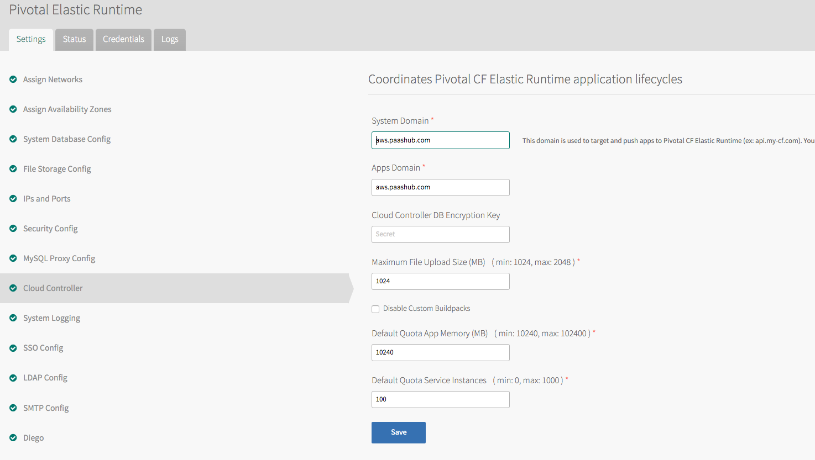
Pivotal OpsManager
Simple interface allows a streamlined set up and configuration

Slide 7
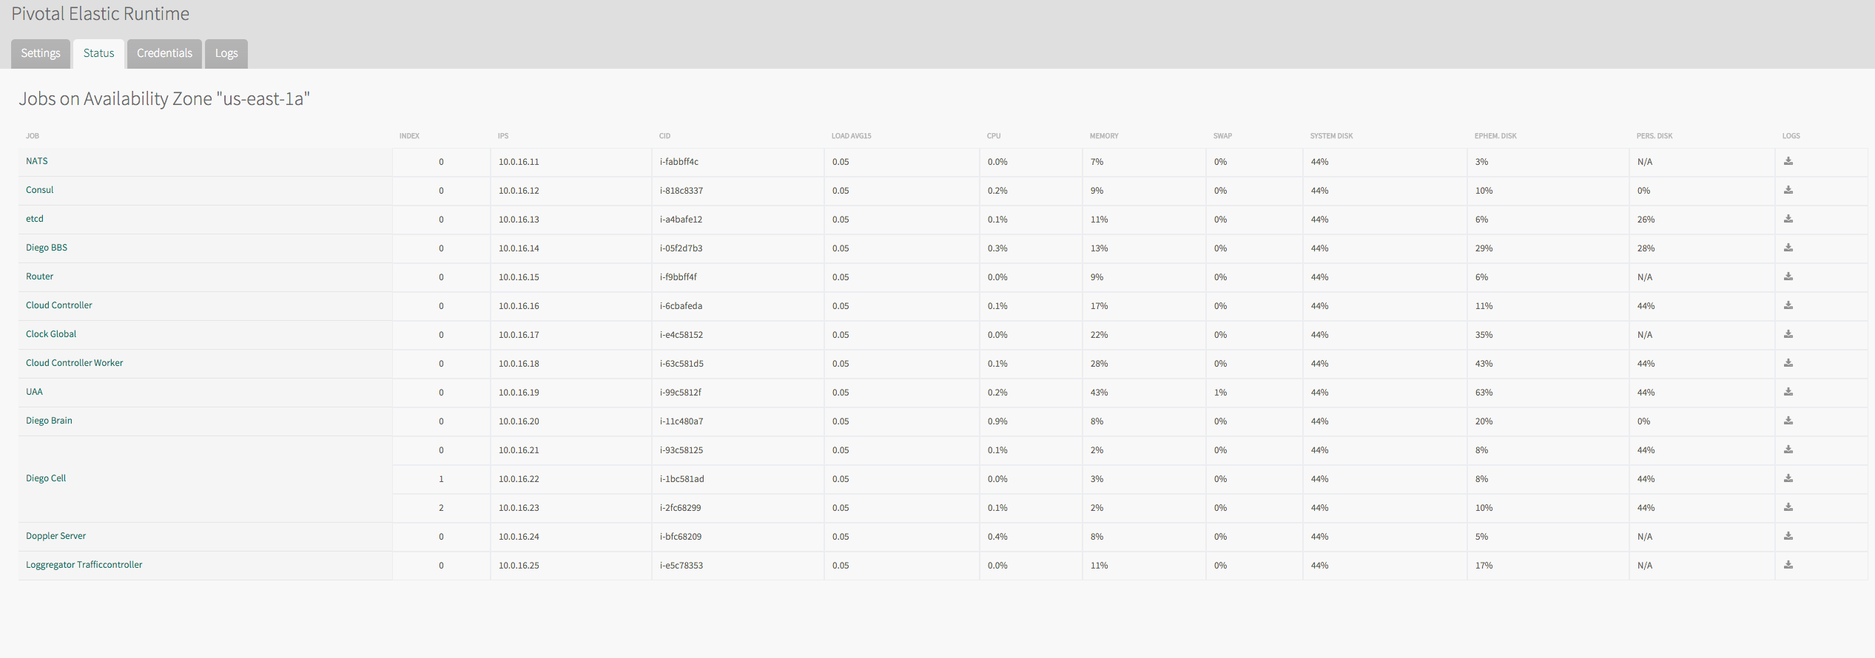
Pivotal OpsManager
Built-in platform monitoring

Slide 8
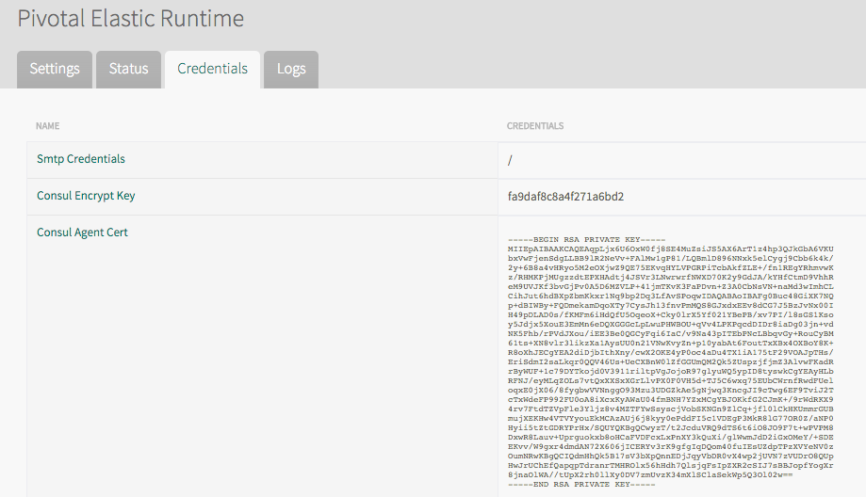
Pivotal OpsManager
Credentials management

Slide 9
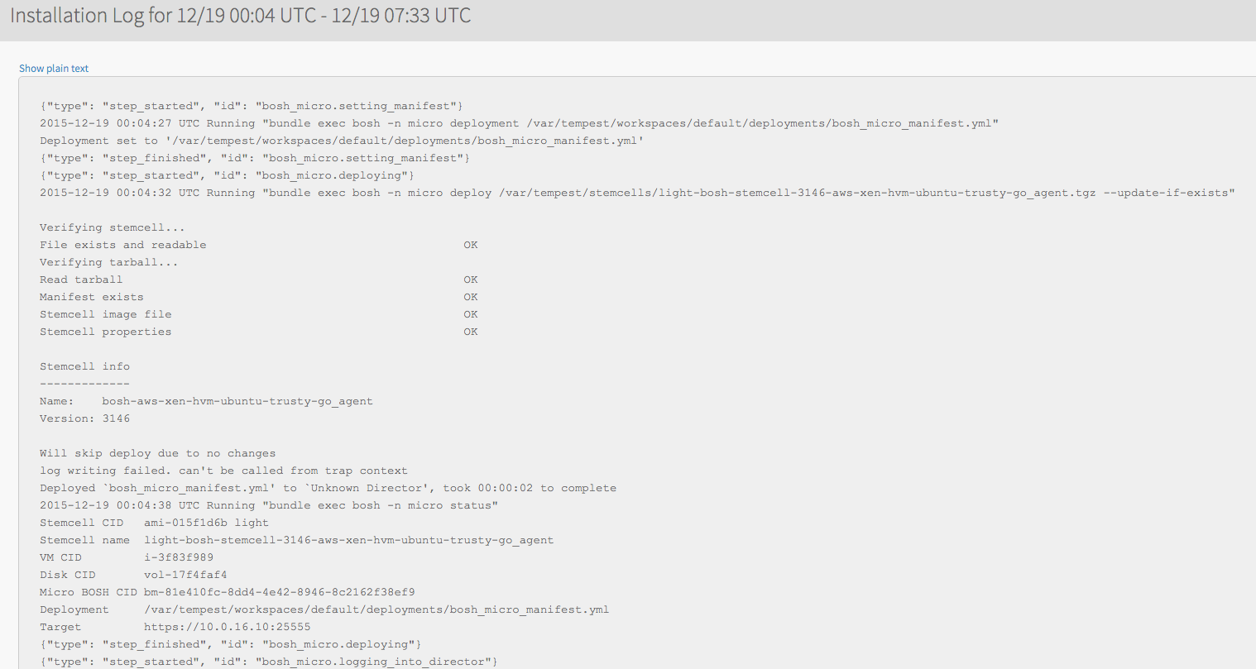
Pivotal OpsManager
Explore install logs

Slide 10
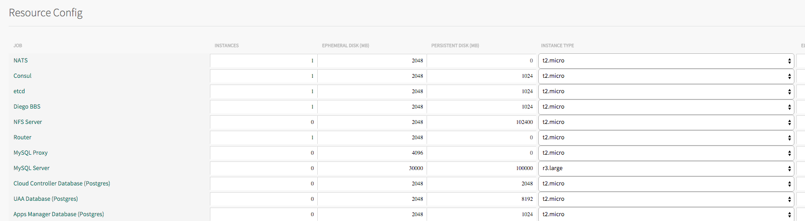
Pivotal OpsManager
Scale the platform

Slide 11
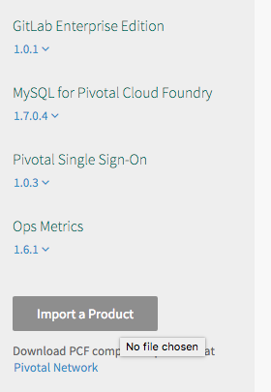
Pivotal OpsManager
Easily import new products

Slide 12

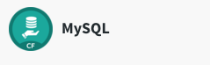




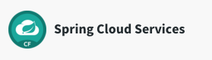


Pivotal Network
Pivotal Network provides a rich set of products for Pivotal OpsManager
https://network.pivotal.io/
BOSH
IaaS

Slide 13
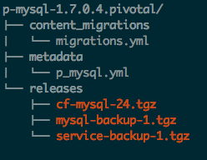
Pivotal Product
Migration from previous versions
Manifest templates and UI rendering
BOSH releases

Slide 14
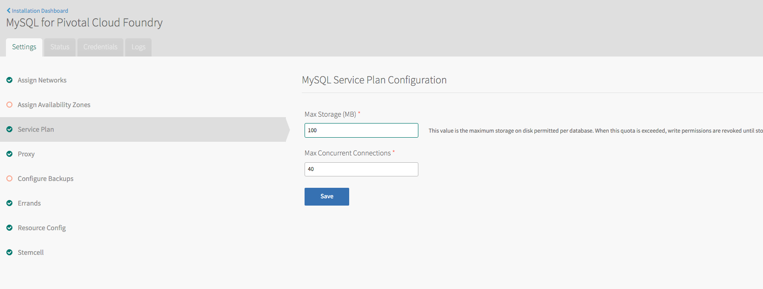
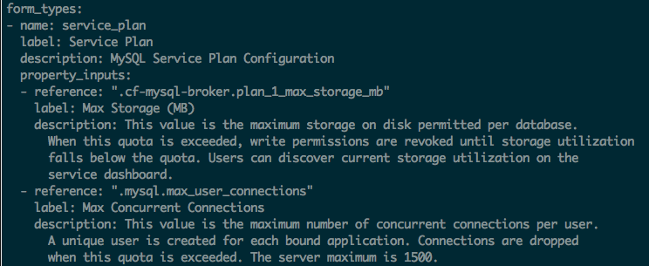
Pivotal Product UI rendering

Slide 15
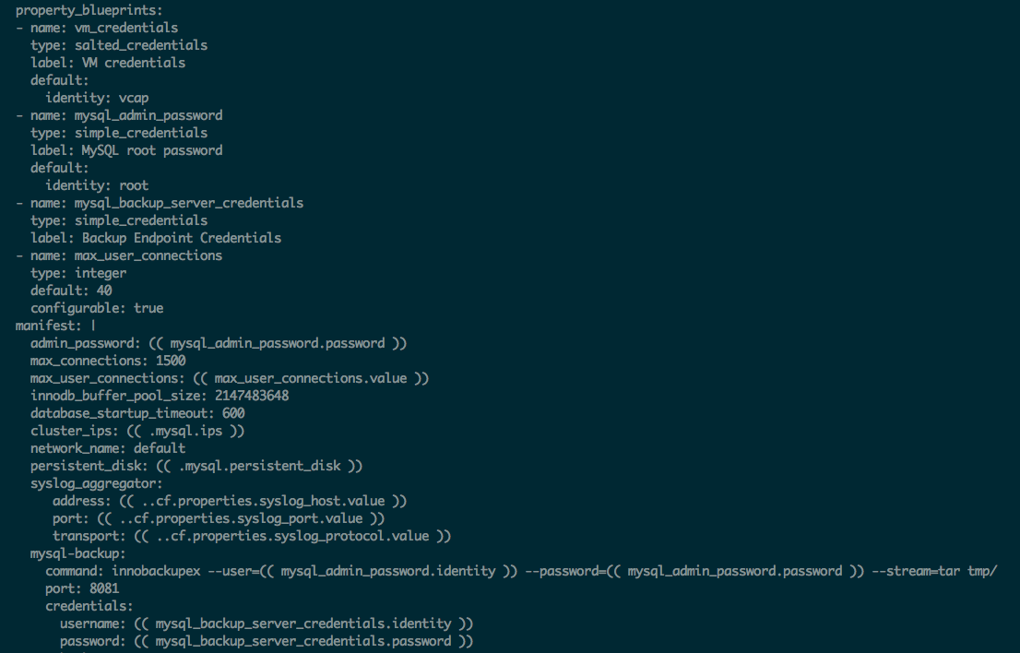
Pivotal Product manifest templates

Slide 16
BOSH 2.0

Slide 17
Bosh 2.0 Features
Name
Manifest v2
Cloud Config
What
Realignment of Manifest
Factor-out IaaS -specific config
Why
Easier to create & maintain
Same Manifest across IaaS types
AZ’s
Links
New First-class Concept
Simplifies, Clarifies Intent
Enapsulate, Name, and Share config

Slide 18
Bosh 2.0 Features
Name
Runtime Config
What
Add-on config for Add’l Agents
Option for changing Instance Groups with AZ feature
Why
Incremental Path for enhancing VMs
?
Manage Persistent disks after VM is destroyed.
Disk can be reused or data migrated
Renaming, Migrating Jobs
Orphaned Disk mgmt

Slide 19
Cloud Foundry
Service Broker
And Marketplace

Slide 20

Services Overview
Operations
Service Marketplace
Developer Experience

Slide 21
Why Pivotal Cloud Foundry Services
Elastic Runtime
MySQL for PCF
Redis
For PCF
RabbitMQ for PCF
Operated ‘as a Service’
Configured and integrated to enable push button deployment.
Full lifecycle management - software updates and patching
Bind to apps through an easy-to-use interface
Common view into access control and audit trails across a breadth of services
PCF Operations Manager
Elastic Runtime integrated into leading data services; all scaled and managed by PCF Ops Manager
Notes:
In many organizations, provisioning of data and messaging services for applications can take weeks, if not months because of the number of teams, administrators and exchange of credentials involved. We are striving to address this problem by providing a common model for services deployment via Pivotal Cloud Foundry that developers can easily find and their applications bind to – and scale those services as needed.
PCF Services allow administrators to provide pre-defined database and middleware services, and this gives developers the ability to rapidly deploy a software product from a menu of options without the typical slow and manual provisioning process. This is also done in a consistent and supportable way. PCF Services are managed and operated ‘as a Service,’ and this means they are automatically configured upon request. The provisioning process also incorporates full lifecycle management support, like software updates and patching.
This automation removes the overhead from developers, who are often saddled with service configuration responsibility. It makes administrators’ lives easier and addresses security risks by standardizing how services are configured and used.
Transition: An important thing to point out is the fact that MySQL and the others Pivotal Services are enterprise ready, what do we mean by that?

Slide 22
And much more…
HIGHLY AVAILABLE
AZ SUPPORT
ROLLING DEPLOYMENT
AUTOMATED VERSION UPGRADES
As an Application Developer, I expect my services to be resilient to failure, so that my application maintains uptime.
As an Operator, I want to deploy services across different IaaS Availability Zones, so that an AZ failure does not take the whole service offline
As an Application Developer, I do not expect to experience a prolonged outage during a deployment of the service, so that I can maintain uptime..
I expect all components of a service to be upgraded to the latest versions automatically through OpsManager, so that I do not have to perform any manual steps.
OPERATIONAL MONITORING & LOGGING
As an Operator, I want visibility into the operational health, performance and logs of my services, so that i can monitor their uptime and diagnose any issues
BACKUP & RESTORE
As an Operator, I expect all services to be able to be backed up and restored, so that I can provide disaster recovery facilities
SCALE
As an Operator, I expect my services to operate at scale, so that i can handle large workloads.
MORE..
Notes:
1. Each service should offer some form of redundancy in the event of a component failure
2. Support for a service to be deployed across multiple availability zones

Slide 23


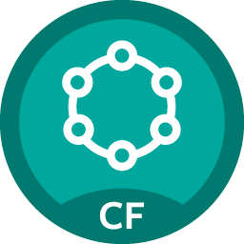




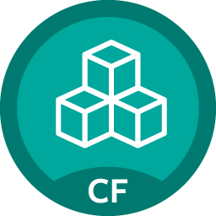











Pivotal Cloud Foundry Service
Mobile
Datastore
Other
Cloud-native
API Gateway
Redis
DataStax Cassandra
RabbitMQ
Config Server
Push Notifications
MySQL
GemFire
Jenkins Enterprise by CloudBees
Service Directory
Data Sync
Session state caching
PivotalHD (BETA)
Spring XD (BETA)
Circuit Breaker
App Distribution
Neo4j (BETA)
MongoDB (BETA)
Single Sign-on

Slide 24
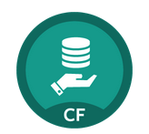
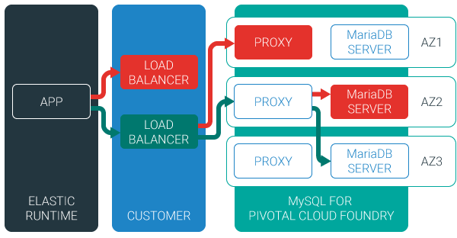
Example: MySQL Service
Relational Database as a service
Minimized effort to create, configure, and manage a MySQL cluster
Multi-node cluster
Data replication across nodes
Failover functionality ensures app traffic only routed to healthy nodes
Notes:
Deployed with a multi-node cluster; Balanced across Availability zones
Highly Available
Data replication
Failover functionality
Customizable plans
Secure - Different credentials to each application, operators can revoke access selectively!

Slide 25
CUSTOM SERVICES IN PCF
Notes:
One of the great things about Pivotal Cloud Foundry® (PCF) is how easy it is for 3rd parties to add in new capabilities. In particular, by using the Operations Manager to easily import, install and expose new services to users of the platform.
What: What these services are, are tiles that you can easily import into the Ops Manager and implement new services within PCF that are provided by our third party partners. These are other products that are developed by other people, but can be deployed in and managed by Cloud Foundry under the control of the Ops Manager.
Why: Why would you want to do this? This means that you can easily implement these new services in your environment, you can run them on a variety of platforms depending on the particular service itself, and you can still get commercial support from those providers. They’re providing a different way to deliver their product to you and to your developers and operations teams, an easy way to consume from the PCF console.

Slide 26
3 options
Service Broker
A simple and consistent way to access services that may be running on top of Cloud Foundry, controlled by Cloud Foundry or running totally independently of Cloud Foundry.
5 RESTful APIs
Expose services in the marketplace
Custom PCF Tile
Service instance managed inside Pivotal Cloud Foundry.
Most of the time uses a Service Broker.
Enterprise grade services.
Same experience as PCF Products
User-Provided
Service instance which have been provisioned outside of Cloud. Foundry.
Behave like other service instances once created.
Eliminate the need to hard code service instance endpoints.
Notes:
There are 3 way to get your own services in PCF
1. Service broker - A service broker is a set of 5 REST endpoints that implement the lifecycle of developers interacting with a service. A service broker can run on PCF, or anywhere else, and it’s URL is registered with PCF. Most customers create service brokers for existing enterprise services that are managed externally but are used by many applications, like an Oracle database or a message broker. Most PCF products also create a service broker as part of the installation. Note that service brokers do not act as a proxy between an application and the service. All application and service communication is direct via the native protocol (JDBC, JMS, etc.).
2. Note that most PCF products ultimately expose themselves as services in Elastic Runtime, but this is not always the case (ex. Ops Metrics).
3.

Slide 27

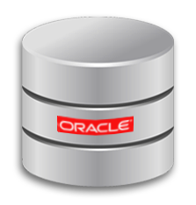
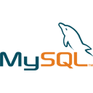


Service broker
Use-cases
Integrating with externally hosted SaaS products.
Integrating with on-premise but external to PCF (i.e. Legacy database)
Official Service Brokers
App Direct
External PostGres
External Oracle
External MS-SQL
External RDS, SQS
No on-premise deployable solution.
Comprehensible/Reliable API
Complex to automate with BOSH
When
Service Broker
Write a service broker that is deployed to PCF (as a VM or the runtime)
Integrate with the external service
Service API
Seamless Experience for developers
Treated as a product (maintenance, support, etc.)
Why
Full instructions can be found here http://docs.pivotal.io/pivotalcf/services/overview.html
Notes:
How does this approach work?
Write a service broker that is deployed to PCF (either as a VM or the runtime)
Integrates with the external service
What services is this approach suitable for?
Integrating with externally hosted SaaS products (such as AWS)
Integrating with on-premise but external to PCF solutions (such as a legacy database)
Decision criteria to use this approach?
There is no on-premise deployable solution!
This is a simpler first implementation
The service has a comprehensive and reliable API
The service is operationally immature or complex to automate with BOSH
Why use this approach?
Leverages the power of the Services API
Integrates the external services into PCF, giving a seamless experience for application developers
It’s treated as a Product
Which ensures quality, maintenance, support.
It’s a real thing

Slide 28
Service Broker API
/v2/catalog [GET]
/v2/service_instances/:id [PUT]
/v2/service_instances/:instance_id/service_bindings/:id [PUT]
/v2/service_instances/:instance_id/service_bindings/:id [DELETE]
/v2/service_instances/:id [DELETE]
Notes:
The 5 REST endpoints that are exposed are:
Catalog - The catalog method is intended to get information about the service, such as a description of the service and different plans available. The catalog method is what gets displayed in the Elastic Runtime marketplace.
Create - The create method should create resources in the service. Those resources may be a new database or schema in a database, a new queue in a message broker, or a folder structure in a filesystem service. The create method will typically create new credentials for the service instance as well.
Bind - The bind method is invoked when an application binds to a service, and is responsible for returning connection information such as a URL or credentials to PCF. PCF then injects that information into the application via an environment variable called VCAP_SERVICES. This is similar to binding to a user-provided service. Best practice: Each binding is represented by its own credentials
Unbind - Unbinding tells the service broker to clean up any resources created during binding. Typically it will disallow access to the service.
Delete - The delete method should clean up any resources created by the create method, such as deleting a database or schema that was created.

Slide 29
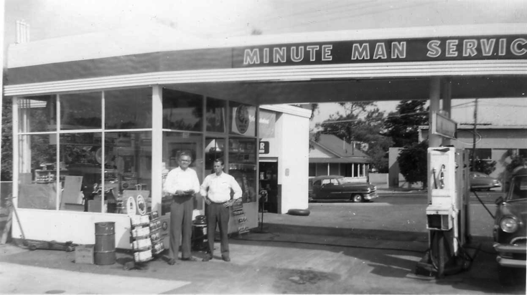
What is a Service?
Allows resources to be easily provisioned on-demand.
Typically middleware, frameworks, and other “components” necessary for applications.
Can be a persistent, stateful layer

Slide 30

2 types of Services
Managed – Fully integrated, with fully lifecycle management
User-Provided – Created and managed externally to the Platform.

Slide 31
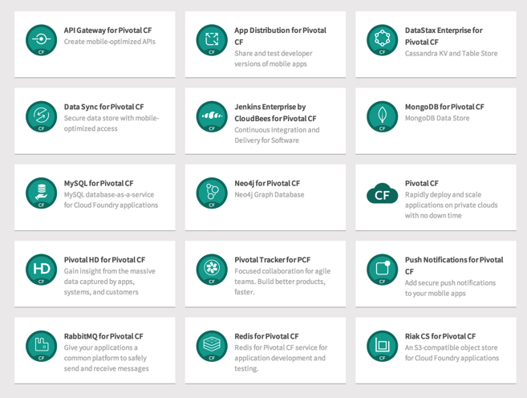
Managed Services
Managed Services are integrated with PCF by implementing a documented API.
A self-service catalog of databases, analytics and middleware technologies:
Production ready
Integrated lifecycle management
Managed credentials
Role-based access
Service Broker is a component which implements the Service API. Service brokers advertise a catalog of service offerings and service plans to Cloud Foundry.

Slide 32
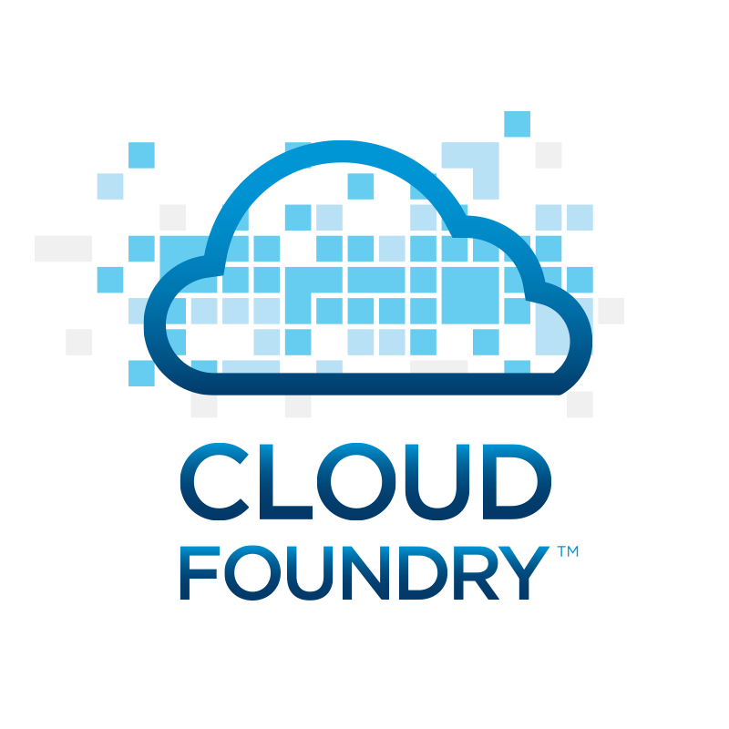
Service Creation & Binding
DB
Service
credentials
CLI
create service (HTTP)
Cloud Controller
create service (HTTP)
Service
Broker
reserve resources
Data
Service
Router
bind service (HTTP)
bind service (HTTP)
obtain connection data
Runtime
Notes:
An application runs in a DEA, which is a droplet execution agent. The Cloud Controller orchestrates the routing and lifecycle of all DEAs in the pool. Routers manage application traffic. Health Manager reports mismatched application states to the CC. A service gateway provides an interface for services (native or external). A messaging bus manages all system communication. Apps are accessed directly through the router while web and CLI clients (e.g., vmc, STS) access Cloud Controller via RESTful services.

Slide 33
Developer Experience
Notes:
One of the great things about Pivotal Cloud Foundry® (PCF) is how easy it is for 3rd parties to add in new capabilities. In particular, by using the Operations Manager to easily import, install and expose new services to users of the platform.
What: What these services are, are tiles that you can easily import into the Ops Manager and implement new services within PCF that are provided by our third party partners. These are other products that are developed by other people, but can be deployed in and managed by Cloud Foundry under the control of the Ops Manager.
Why: Why would you want to do this? This means that you can easily implement these new services in your environment, you can run them on a variety of platforms depending on the particular service itself, and you can still get commercial support from those providers. They’re providing a different way to deliver their product to you and to your developers and operations teams, an easy way to consume from the PCF console.

Slide 34
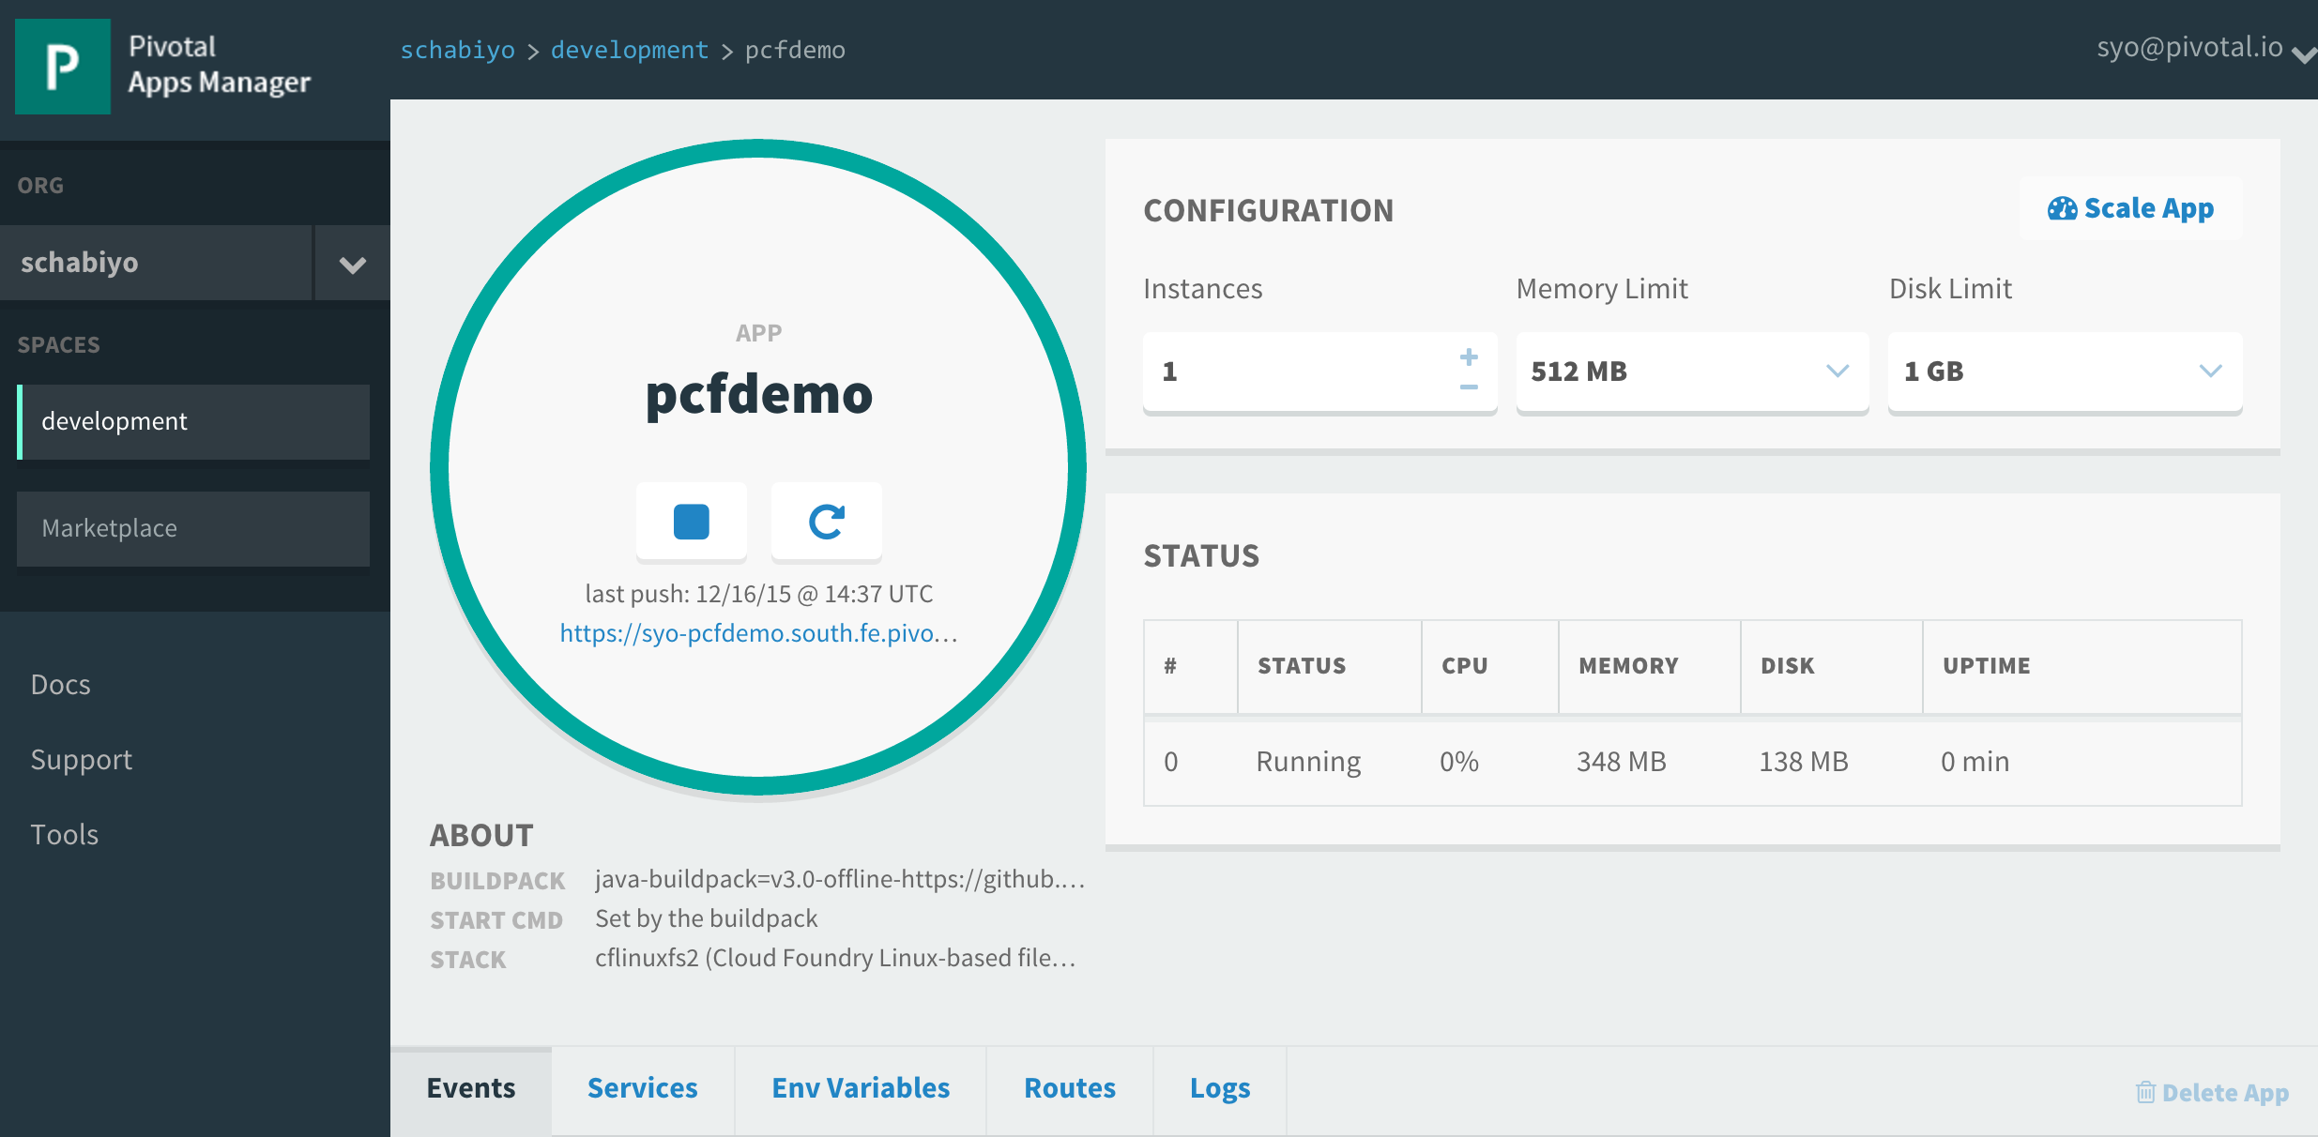
Example: Service Creation & Binding
Click on "Marketplace"
Create Service
Bind service
Restart App
Verify

Slide 35
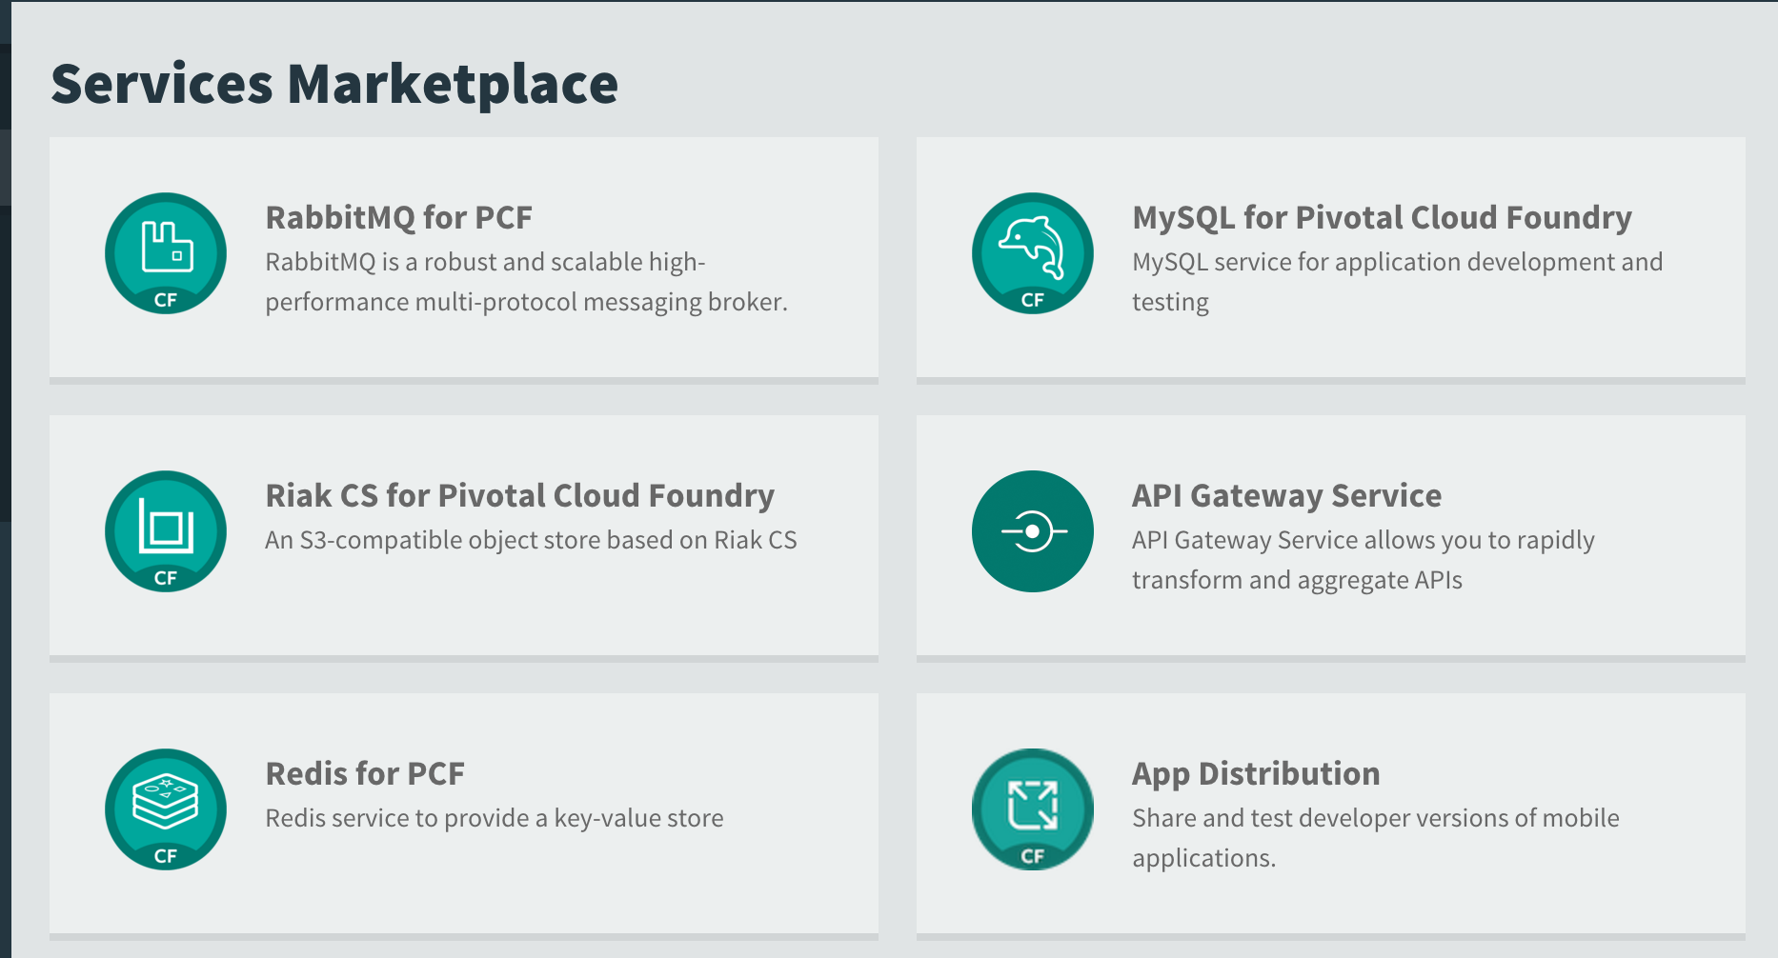
Example: Service Creation & Binding
Choose ”RabbitMQ for PCF"
Create Service
Bind service
Restart App
Verify

Slide 36
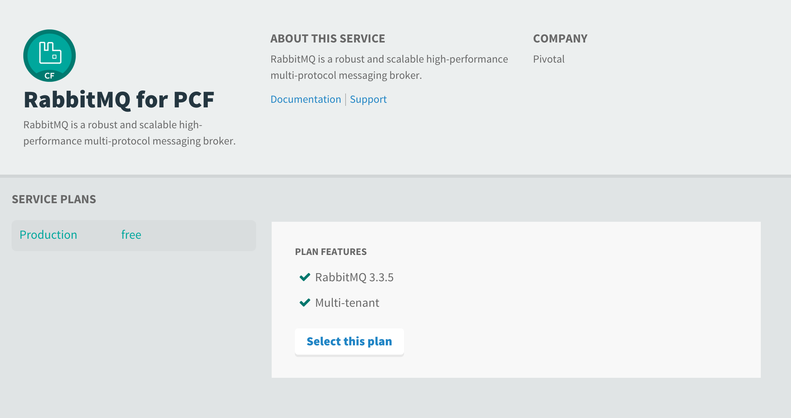
Example: Service Creation & Binding
Select the free plan
Create Service
Bind service
Restart App
Verify

Slide 37
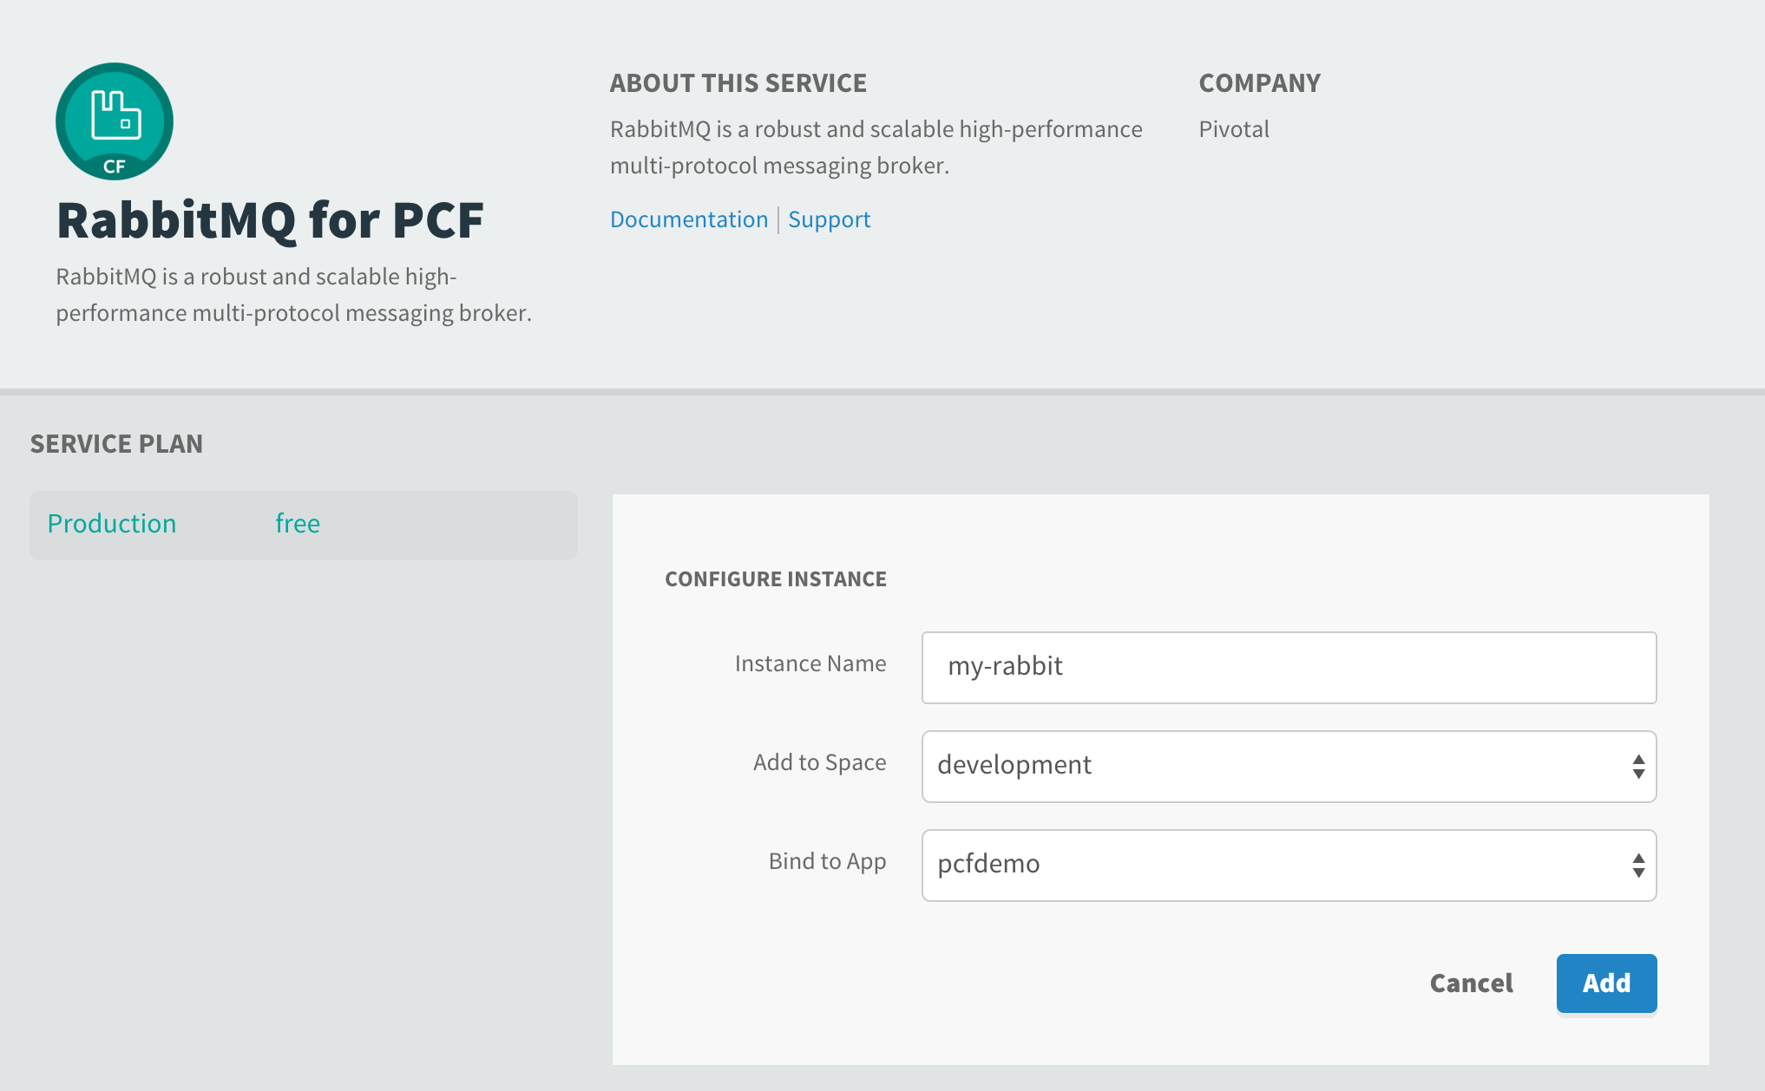
Example: Service Creation & Binding
Give it a name and bind it to your application
Create Service
Bind service
Restart App
Verify

Slide 38
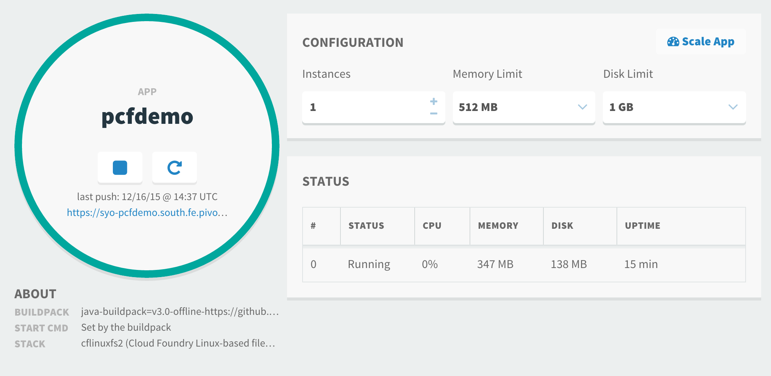
Example: Service Creation & Binding
Create Service
Bind service
Restart App
Verify

Slide 39
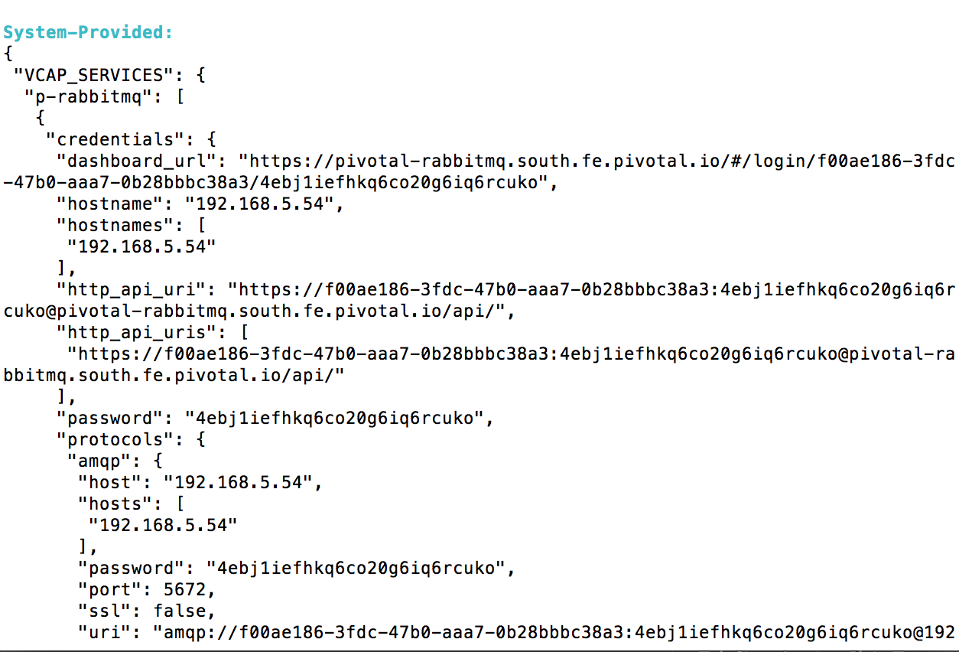
Example: Service Creation & Binding
$ cf env pcfdemo
Create Service
Bind service
Restart App
Verify

